Slide 1
CREATIVITY SOURCE OF NEW IDEA IDEAS INTO OPPORTUNITIES

Slide 2


CREATIVITY
Creativity is defined as the tendency to generate or recognize ideas, alternatives, or possibilities that may be useful in solving
problems, communicating with others, and entertaining ourselves and others.
Creativity is the ability to come up with new ideas and to identify new and different ways of looking at a problem and opportunities.
A process of assembling ideas by recombining elements already known but wrongly assumed to be unrelated to each other. This definition has several key elements that are worth considering:
Process: Creativity is also a process (implying, among other things, that it is more like a skill than an attitude, and that you can get better at it with practice).
Ideas: Creativity results in ideas that have potential value.
Recombining: The creative process is one of putting things together in unexpected ways.

Slide 3
THREE REASONS WHY PEOPLE ARE MOTIVATED TO BE CREATIVE:
Need for novel, varied, and complex stimulation.
Need to communicate ideas and values.
Need to solve problems.
In order to be creative, you need to be able to view things in new ways or from a different perspective.
Among other things, you need to be able to generate new possibilities or new alternatives.
Tests of creativity measure not only the number of alternatives that people can generate but the uniqueness of those alternatives.
The ability to generate alternatives or to see things uniquely does not occur by change; it is linked to other, more fundamental qualities of thinking, such as flexibility, tolerance of ambiguity or unpredictability.
Thus, creativity is the development of ideas about products, practices, services, or procedures that are novel and potentially useful to the organization.

Slide 4

TYPES OF CREATIVITY
Primary creativity : deals with spontaneous creations.
Secondary creativity : is more deliberate and skilled as in the application of ideas and insight to inventions.
Technical creativity : aims at finding out improvement in a process so as to improve efficiency.
Inventive creativity : aims at making or devising new combination of ingredients
Innovative creativity : it involves for reaching application of more basic ideas such as management application of principles of psychology to develop a much more effective system for motivating staff.
Emergentive creativity : it consist of new revolutionary principles for an art or science such as psycho- analytical concepts of Freud.

Slide 5

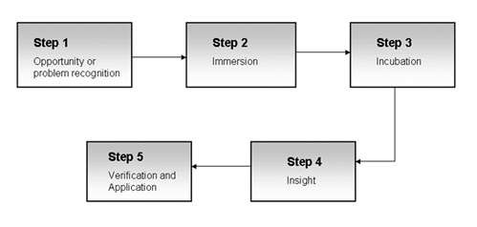
THE CREATIVE PROCESS

Slide 6
STEPS IN THE CREATIVE PROCESS
Opportunity or Problem Recognition: A person discovers that a new opportunity exists or a problem needs resolution.
Immersion: The individual concentrates on the problem and becomes immersed in it. He or she will recall and collect information that seems relevant, dreaming up alternatives without refining or evaluating them.
Incubation: The person keeps the assembled information in mind for: a while. He or she does not appear to be working on the problem actively; however, the subconscious mind is still engaged. While the information is simmering it is being arranged into meaningful new patterns.
Insight: The problem-conquering solution flashes into the person's mind at an unexpected time, such as on the verge of sleep, during a shower, or while running.
Verification and Application: The individual sets out to prove that the creative solution has merit. Verification procedures include gathering supporting evidence, using logical persuasion, and experimenting with new ideas.

Slide 7

PERSONALITY TRAITS OF CREATIVE PEOPLE
◆ Persistence
◆ Self-confidence
◆ Independence
◆ Attraction to complexity
◆ Tolerance of ambiguity
◆ Intuitiveness
◆ Have broad interests
◆ Are energetic
◆ Drive to achieve
◆ Love their work
◆ Take risks

Slide 8

BARRIERS TO CREATIVITY
◆ Excessive focus on extrinsic motivation
◆ Limits set by superiors
◆ Critical evaluation
◆ Close, controlling supervision
◆ Competition in a win-lose situation
◆ Control of decision making
◆ Control of information
◆ Blindly following the rules
◆ Constantly being practical
◆ Becoming overly specialized
◆ Fearing looking foolish
◆ Fearing mistakes and failure

Slide 9


INNOVATION
Innovation is the implementation of new ideas at the individual, group or organizational level.
A process of intentional change made to create value by meeting opportunity and seeking advantage.
Process: Innovation is a process (implying, among other things, that it can be learned and managed).
Intentional: That process is carried out on purpose.
Change: It results in some kind of change.
Value: The whole point of the change is to create value in our economy, society and/or
individual lives.
Opportunity: Entrepreneurial individuals enable tomorrow's value creation by exploring for it today: having ideas, turning ideas into marketable insights and seeking ways to meet opportunities.
Advantage: At the same time, they also create value by exploiting the opportunities they
have at hand.

Slide 10
THE INNOVATION PROCESS
Analytical planning – Carefully identifying the product or service
features, design as well as the resources that will be needed.
Resource organization – Obtaining the required
resources, materials, technology, human or capital resources.
Implementation – Applying the resources in order to accomplish the plans
Commercial application – The provision of value to customers, reward
employees, and satisfy the stake holders.

Slide 11

CREATIVITY, INNOVATION AND ENTREPRENEURS
Creativity is thinking new things, and innovation is doing new things.
Creativity is the ability to develop new ideas and to discover new ways of looking at problems and opportunities.
Innovation is the ability to apply creative solutions to those
problems and opportunities in order to enhance people‟s lives or
to enrich society.
Entrepreneurship = creativity + innovation

Slide 12
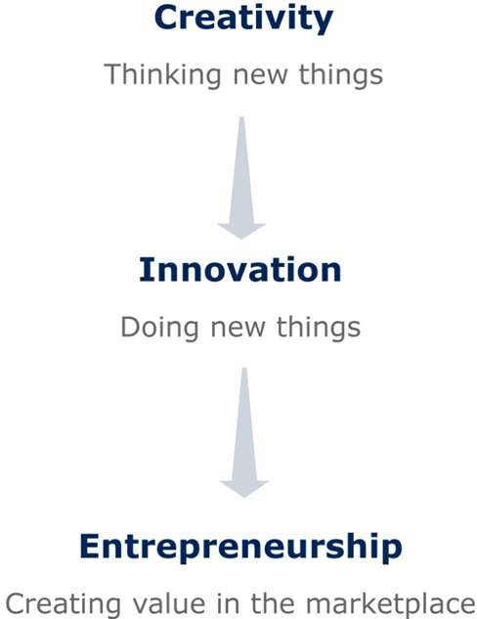
FROM CREATIVITY TO ENTREPRENEURSHIP

Slide 13
CREATIVITY, INNOVATION AND ENTREPRENEURS
Creativity is the ability to develop new ideas and to discover new ways of looking at problems and opportunities.
Innovation is the ability to apply creative solutions to those problems and opportunities in order to enhance people‟s lives or to enrich society.
Entrepreneurship is the result of a disciplined, systematic process of applying creativity and innovation to needs and opportunities in the marketplace.
Entrepreneurs are those who marry their creative ideas with the purposeful action and structure of a business.
Researchers believe that entrepreneurs succeed by thinking and doing new things or old things in new ways.

Slide 14
SOURCE OF NEW IDEA
Basic research : all firms are engaged in some kind of basic research and development , which can lead to development of new product ideas that have already passed the initial screening stage.
Production stage : workers actively engaged in the production of products can suggest certain modifications and improvements. These workers can provide ideas aimed at improving quality , cost and performance of potential product.
Sales force : sales representative are directly in touch with the customers and are thus better equipped to take note of customer needs by this they can provide better product development idea.
Management : management team based on their knowledge, skill and experience can come out with new ideas for product development.

Slide 15
Magazines and trade journal : useful ideas about new products can be obtained from these magazines and trade journals.
Competitors : in order to survive in present day competitive environment, it is in the interest of the entrepreneur to keep a eye on activities of his rivals.
Buyers : an entrepreneur while keeping track of the requirements of the consumers can definitely get useful ideas aimed at developing a better product.
Sellers : can provide idea for new product development as they act as link between producers and consumers and are better equipped to provide required information.
Overseas market : a producer interested in taking care of foreign market can do it in better manner by getting right ideas aimed at improving product acceptability in these markets.

Slide 16
IDEAS INTO OPPORTUNITIES
New product idea
Idea
screening
Concept developm ent
Potential
analysis
Product developm ent
Test
marketing
Commerc
ialization

Slide 17
IDEAS INTO OPPORTUNITIES
New product idea : an attempt is made to visualize the product. An in depth study may be undertaken to anticipate features of the proposed product. Ideas may be contributed by scientists, professional designers, rivals, customers, sales force etc.
Idea screening : under this step detailed investigation of various ideas is carried on. Those ideas which offer less scope are dropped. Most promising ideas are chosen for product development.
Concept development and testing : all ideas chosen after preliminary screening are subjected to in depth study. These ideas are developed into mature product concepts.
Business potential analysis : after choosing best product idea, detailed investigation is carried out to find its market potential, gestation period, capital investment, and expected rate of return.

Slide 18
Product development : after clearing business potential analysis tests concrete steps are taken for giving practical shapes to the proposed product.
Test marketing : test marketing involves placing fully developed new product for sale and observing its actual performance under propose marketing plan.
Commercialization : is the actual introduction of the product into market place with all the related decisions and resources commitment.

